Slide 1
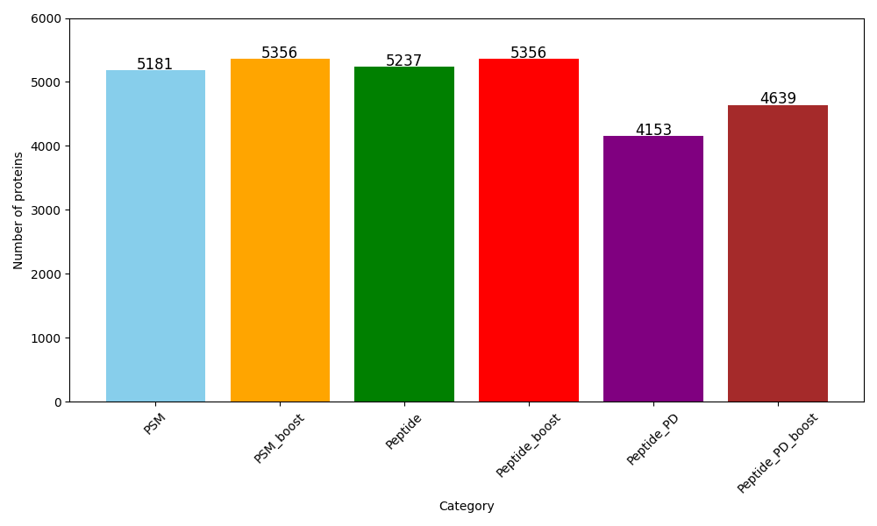
Number of the proteins from different analysis from the same experiment
No IT adjustment

Slide 2
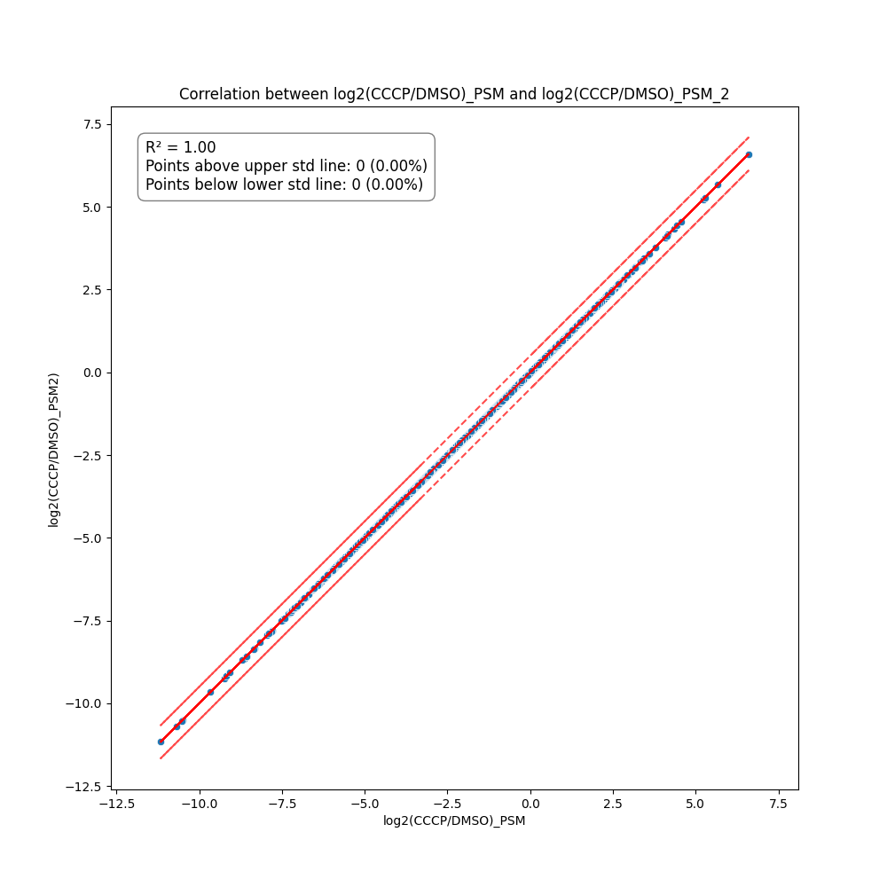
Red lines indicates 0.5 fold changes high and low
Random test: no difference – tested 3 times with same data
Random numbers is between 0 to 1.

Slide 3
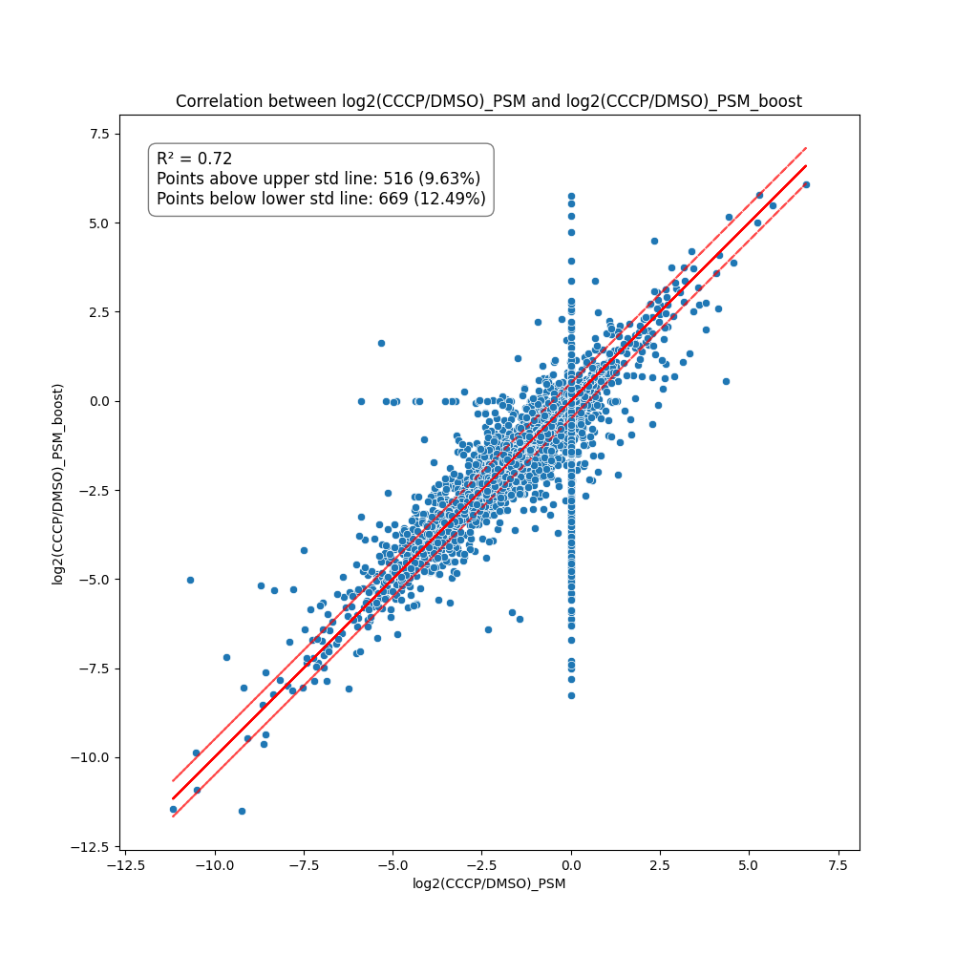

Understand the effect of Boost included in the analysis (PSMs were used)
Samples : CCCP vs DMSO
Merge with all accessions
Merge with only common accessions

Slide 4
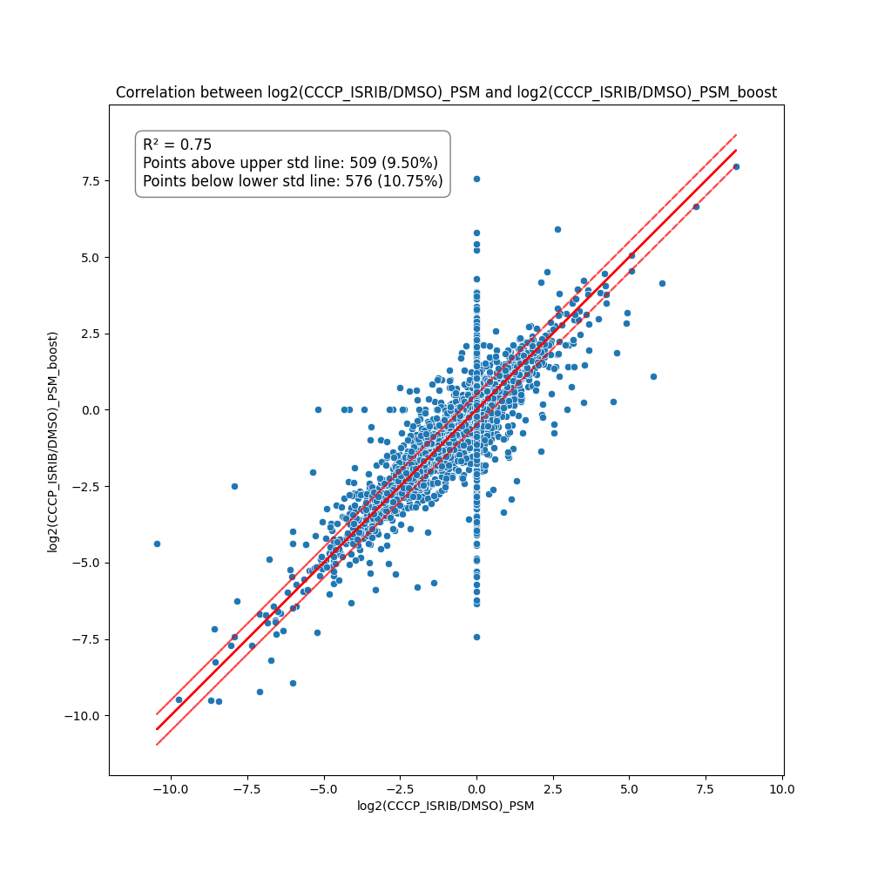

Understand the effect of Boost included in the analysis (PSMs were used)
Samples : CCCP+ISRIB vs DMSO
Merge with all accessions
Merge with only common accessions

Slide 5
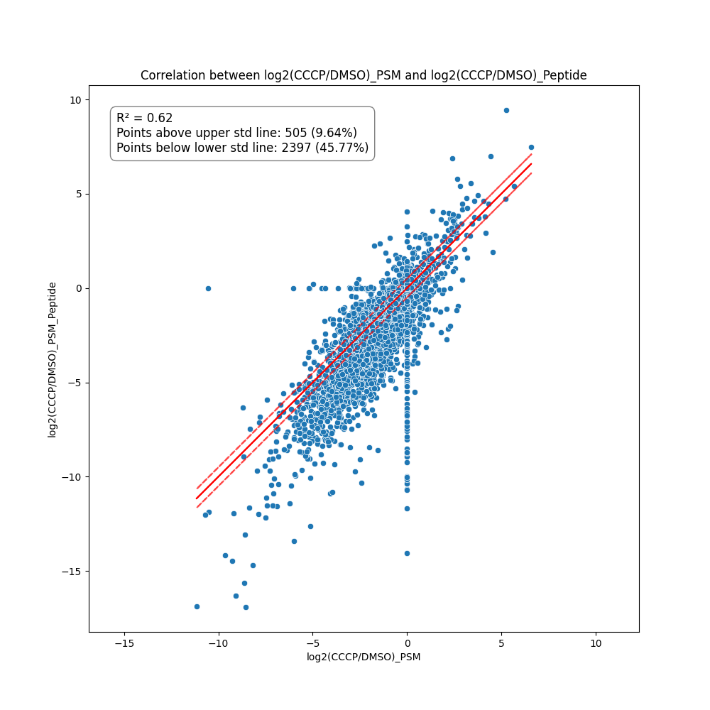
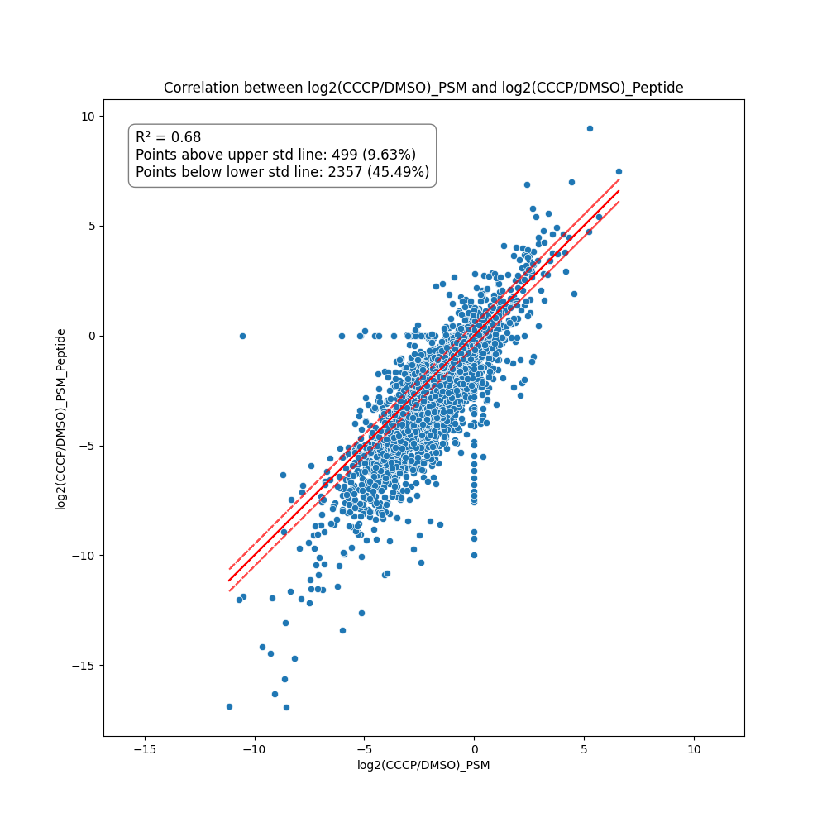
No Booster used!
Understand the effect of PSM calculation vs peptides in LMM
PSMs vs Peptides
PSMs vs Peptides
Samples : CCCP vs DMSO
Samples : CCCP vs DMSO
Merge with all accessions
Merge with only common accessions

Slide 6
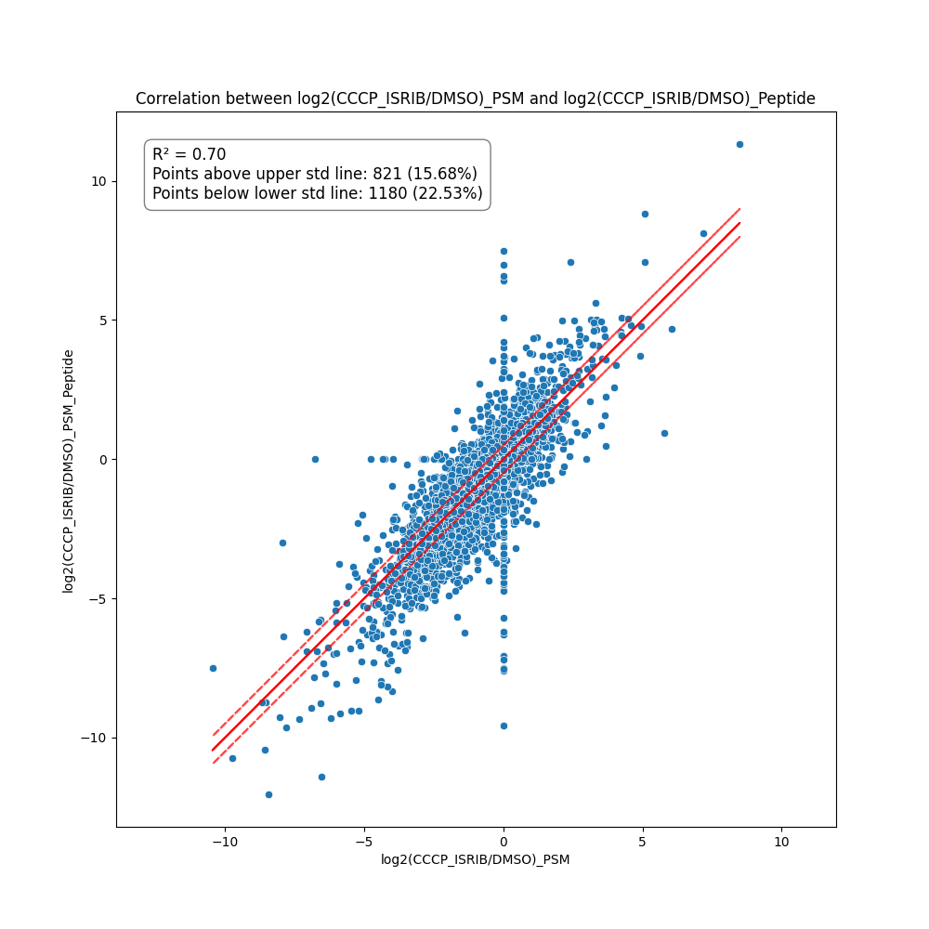

No Booster used!
Understand the effect of PSM calculation vs peptides in LMM
PSMs vs Peptides
PSMs vs Peptides
Samples : CCCP+ISRIB vs DMSO
Samples : CCCP+ISRIB vs DMSO
Merge with all accessions
Merge with only common accessions

Slide 7
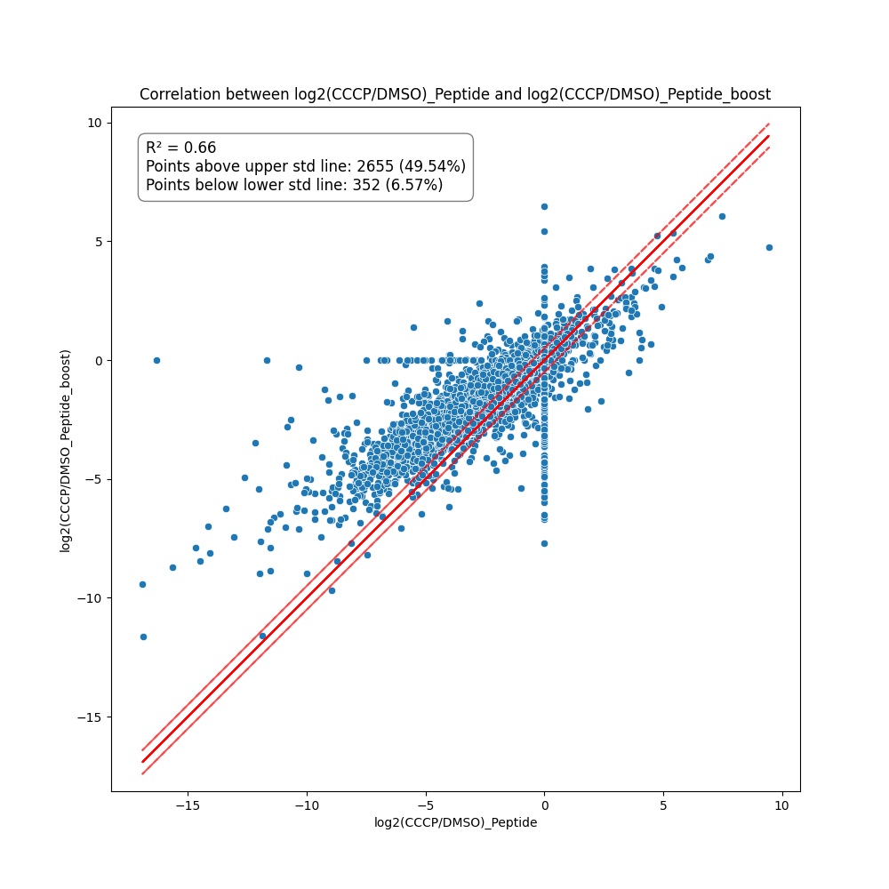
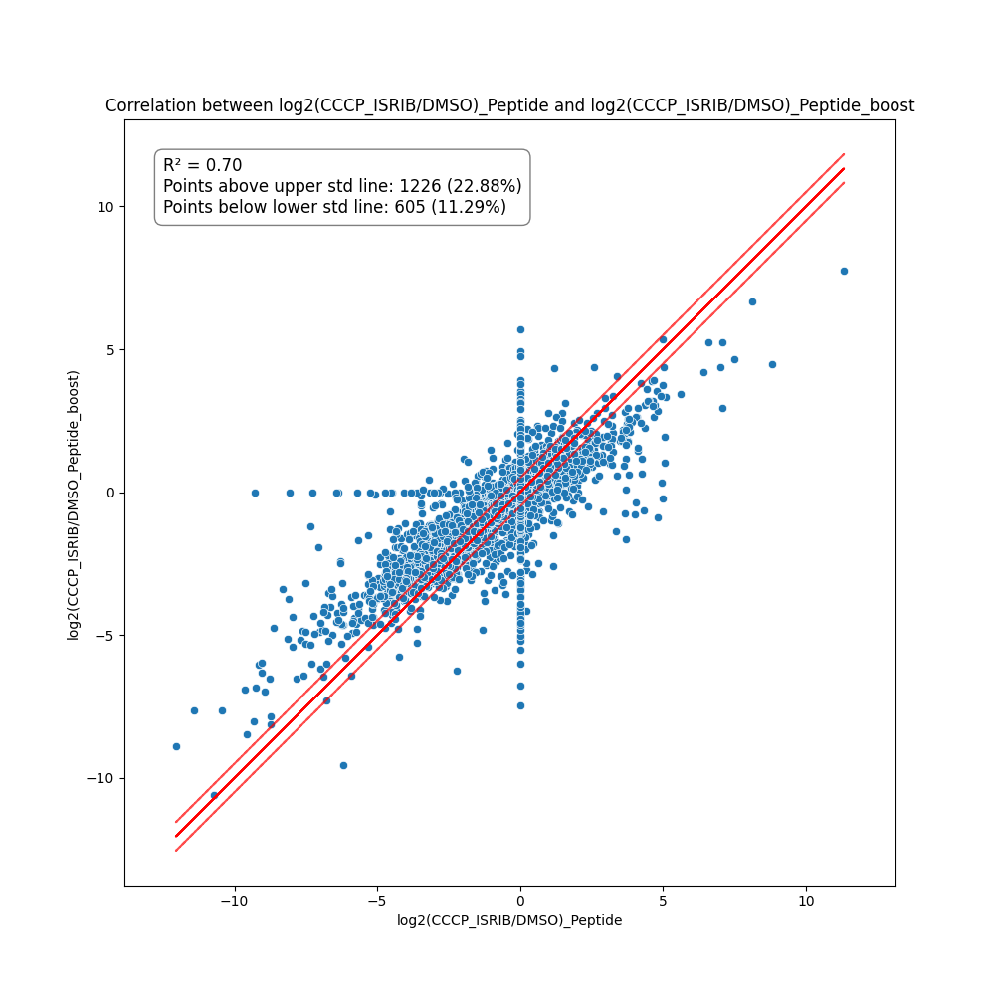
Understand the effect of Boost included in the analysis (Peptides were used)
Samples : CCCP vs DMSO
Samples : CCCP+ISRIB vs DMSO
Merge with all accessions
Merge with all accessions

Slide 8
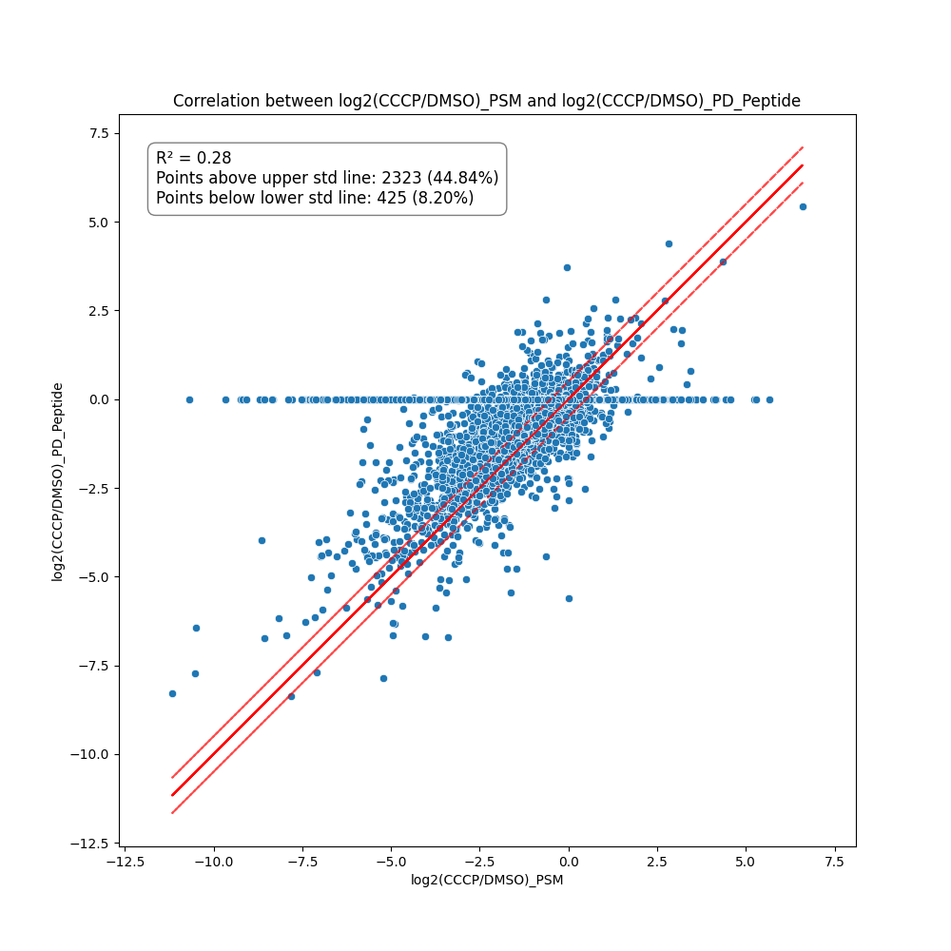
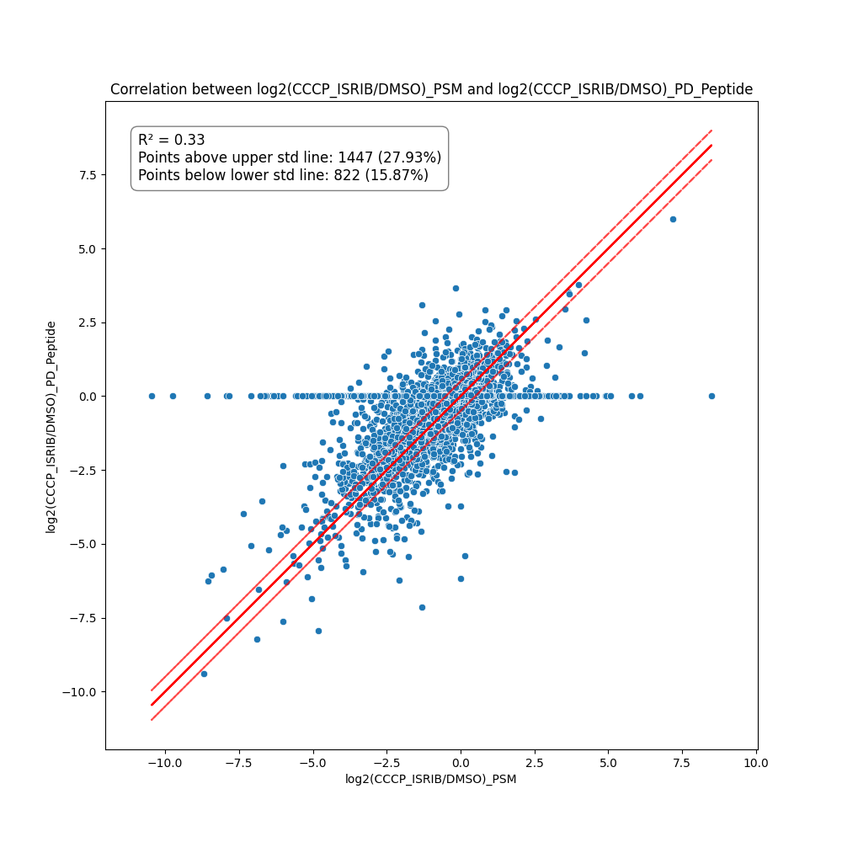
Understand the effect of Peptide file from PD vs PSMs in the analysis
Samples : CCCP vs DMSO
Samples : CCCP+ISRIB vs DMSO
Merge with all accessions
Merge with all accessions

Slide 9
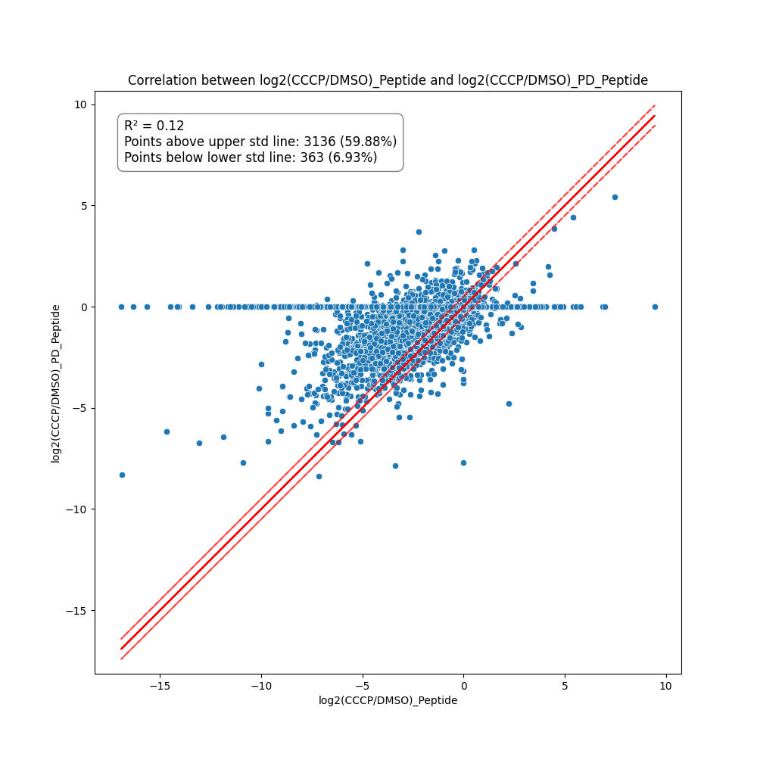
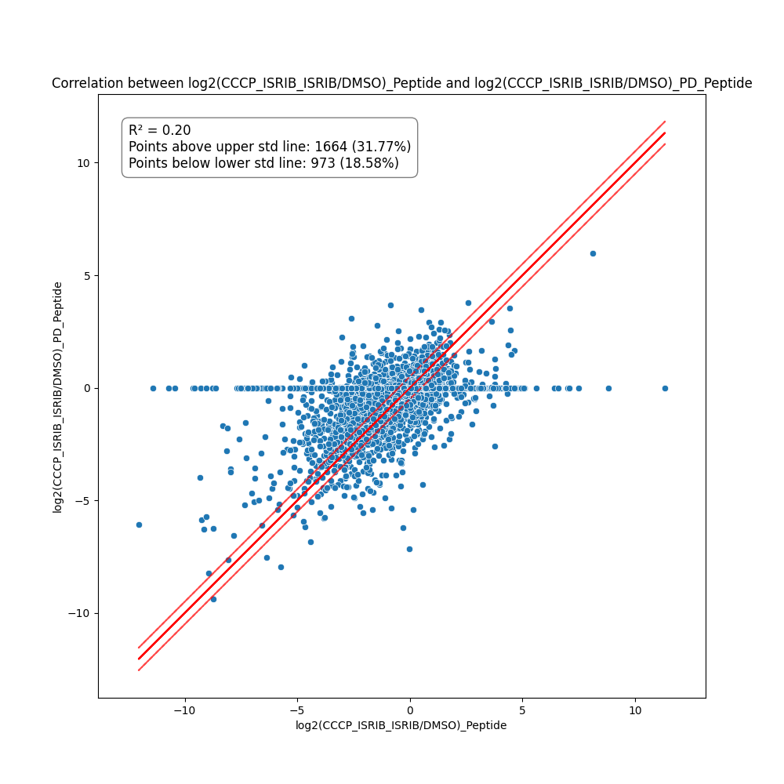
Understand the effect of Peptide file from PD vs peptides in the analysis
Samples : CCCP vs DMSO
Samples : CCCP+ISRIB vs DMSO
Merge with all accessions
Merge with all accessions

